Slide 1


Spatial Machine Learning
Introduction to Spatial Data and Machine Learning
Dr. Giri Rajasekhar Gunnu
Professor of Practice, Andhra University
📧 g.giri.iitm@gmail.com
🔗 LinkedIn: girigunnu

Slide 2
why Matters
Foundations of Spatial Data
1

Slide 3
Types of spatial data
Geographic Information System (GIS) is a powerful tool for capturing, analyzing, and presenting spatial data.
It is widely used in various fields, including urban planning, environmental management, and natural resource management.
Two fundamental data models used in GIS are raster and vector data models.
GIS data represents real-world objects such as roads, land use, elevation with digital data.
The Real world objects or features of earth can be divided into two abstractions: discrete objects (a Tree) and continuous fields (like elevation).

Slide 4
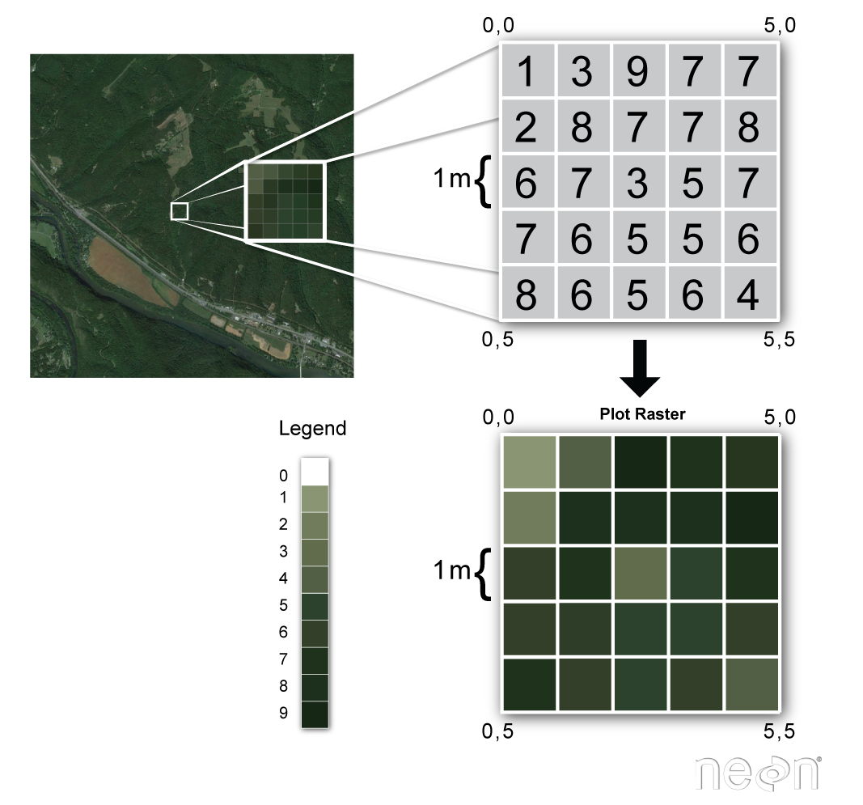
Raster Data Model In GIS
A raster data type is made up of pixel or cells and each pixel is associated with a specific geographical location.
The value of a pixel can be continuous (e.g. elevation) or categorical (e.g. land use).

Slide 5
Raster Data Model In GIS
A geospatial raster is only different from a digital photo in that it is accompanied by spatial information that connects the data to a particular location.
This includes the raster’s extent and cell size, the number of rows and columns, and its coordinate reference system (or CRS).

Slide 6
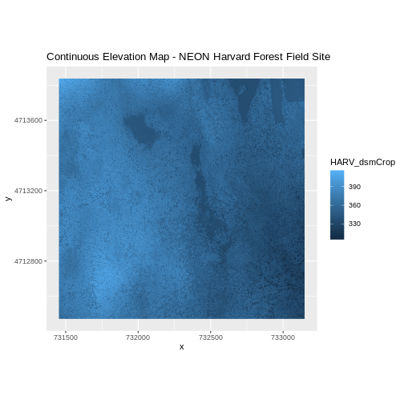
Raster Data Model In GIS
Some examples of continuous rasters include:
Precipitation maps.
Maps of tree height derived from LiDAR data.
Elevation values for a region.
A map of elevation for Harvard Forest derived from the NEON AOP LiDAR sensor is below. Elevation is represented as continuous numeric variable in this map. The legend shows the continuous range of values in the data from around 300 to 420 meters.

Slide 7
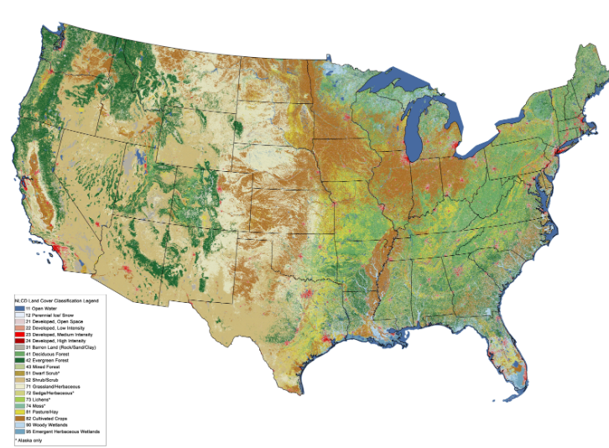
Raster Data Model In GIS
Some rasters contain categorical data where each pixel represents a discrete class such as a landcover type (e.g., “forest” or “grassland”) rather than a continuous value such as elevation or temperature.
Some examples of classified maps include:
Landcover / land-use maps.
Tree height maps classified as short, medium, and tall trees.
Elevation maps classified as low, medium, and high elevation.

Slide 8
Raster Data Model In GIS
Raster data is suitable for analyses involving continuous surfaces, such as slope or temperature gradient analysis.
Raster data is made up of pixels (tiny squares), each representing a specific area on the Earth's surface.
The size of each pixel, known as the Ground Sampling Distance (GSD), determines the resolution of the raster data. A smaller GSD means higher resolution and more detail, while a larger GSD means lower resolution and less detail. Each pixel has a value that represents information, such as color, elevation, or temperature.

Slide 9
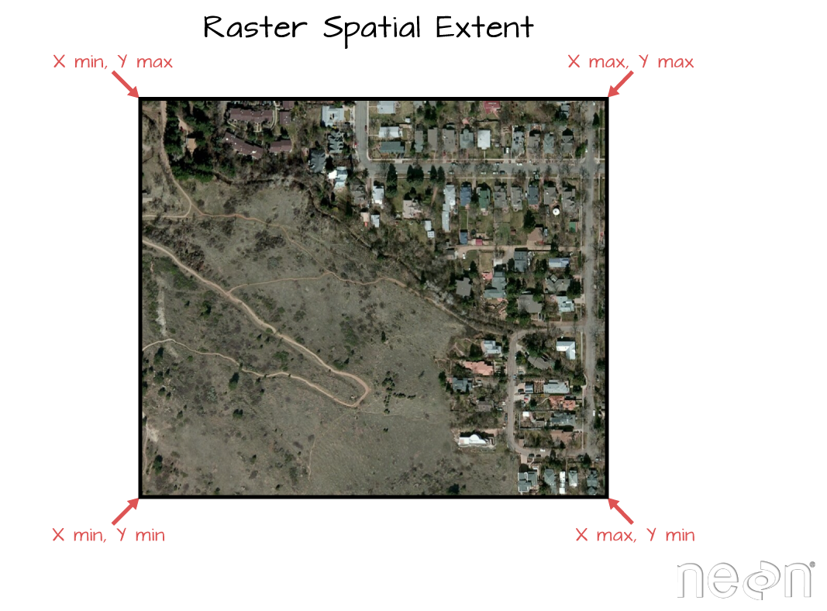
Important Attributes of Raster Data
Extent
The spatial extent is the geographic area that the raster data covers. The spatial extent of an R spatial object represents the geographic edge or location that is the furthest north, south, east and west. In other words, extent represents the overall geographic coverage of the spatial object.

Slide 10
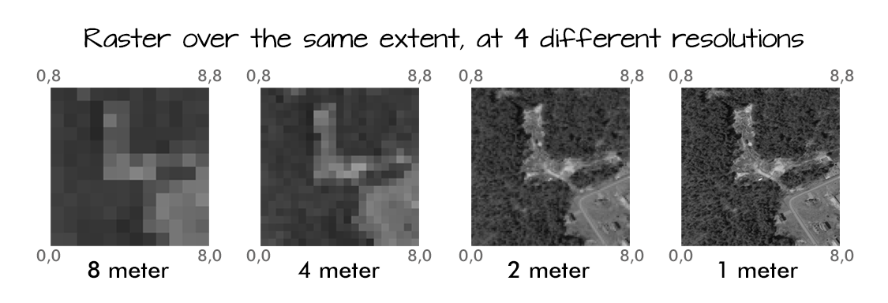
Important Attributes of Raster Data
Resolution
A resolution of a raster represents the area on the ground that each pixel of the raster covers. The image below illustrates the effect of changes in resolution.

Slide 11
Types of raster data
Elevation models (DEM, DTM): Raster data representing elevation values across a terrain surface. Digital Elevation Models (DEM) and Digital Terrain Models (DTM) are examples used for terrain analysis, flood modeling, and viewshed analysis.
‍
Orthophotos (Orthomosaics): High-resolution, georeferenced raster images created by stitching together aerial photographs. Orthomosaics are corrected for distortions caused by terrain relief and camera perspective, used for accurate mapping, land use planning, and environmental monitoring.

Slide 12
Types of raster data
Satellite imagery: Raster data captured by satellites, providing visual representations of the Earth's surface. Used for monitoring land cover changes, agricultural assessments, and urban planning.
‍Land cover and land use maps: Raster datasets categorizing types of land cover (e.g., forest, urban, water) or land use (e.g., residential, commercial, agricultural).
Climate and weather data: Raster datasets capturing meteorological variables such as temperature, precipitation, and humidity, used in climate modeling and environmental studies.

Slide 13
Raster Data Formats
GeoTIFF (.tif) - A widely used format for georeferenced raster images, supporting both spatial data and metadata.
JPEG (.jpg) - Commonly used for compressed photographic images, though not typically used for GIS analysis due to lossy compression.
PNG (.png) - Another raster format that supports transparency and lossless compression, suitable for web-based mapping and GIS applications.

Slide 14
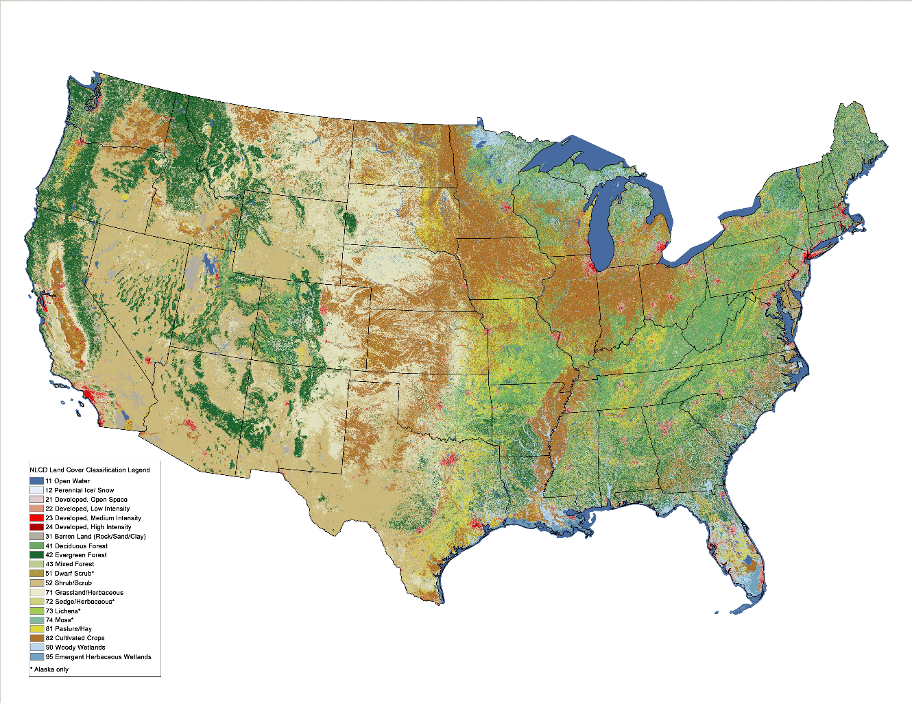
Raster Data Model In GIS
The map above shows the contiguous United States with landcover as categorical data. Each color is a different landcover category. (Source: Homer, C.G., et al., 2015, Completion of the 2011 National Land Cover Database for the conterminous United States-Representing a decade of land cover change information. Photogrammetric Engineering and Remote Sensing, v. 81, no. 5, p. 345-354)

Slide 15
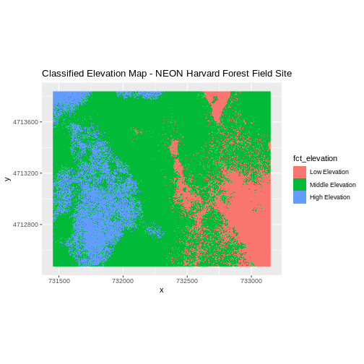
Raster Data Model In GIS
The map right shows elevation data for the NEON Harvard Forest field site.
In this map, the elevation data (a continuous variable) has been divided up into categories to yield a categorical raster.

Slide 16
Raster Data Model In GIS
Digital Photography is the best example of raster data type model, anyone who is familiar with digital photography can recognize the pixels as the smallest individual unit of an image, where each pixel value in the image corresponds to a particular color and the combination of these pixels will create an image.
As of now, the best example of raster data that is commonly used is Aerial photos, with only one purpose, to display a detailed image on a map or for the purposes of digitization.

Slide 17
Raster Data Model In GIS
Raster data type consists of rows and columns of cells and these each cells stores a single value. Raster data can be images (raster images) with each pixel containing a color value.
In Raster, data is represented as a grid of (usually square) cells. Each cell of a raster, stores a single value and it can be extended by using raster bands to represent RGB (red, green, blue) colors.

Slide 18
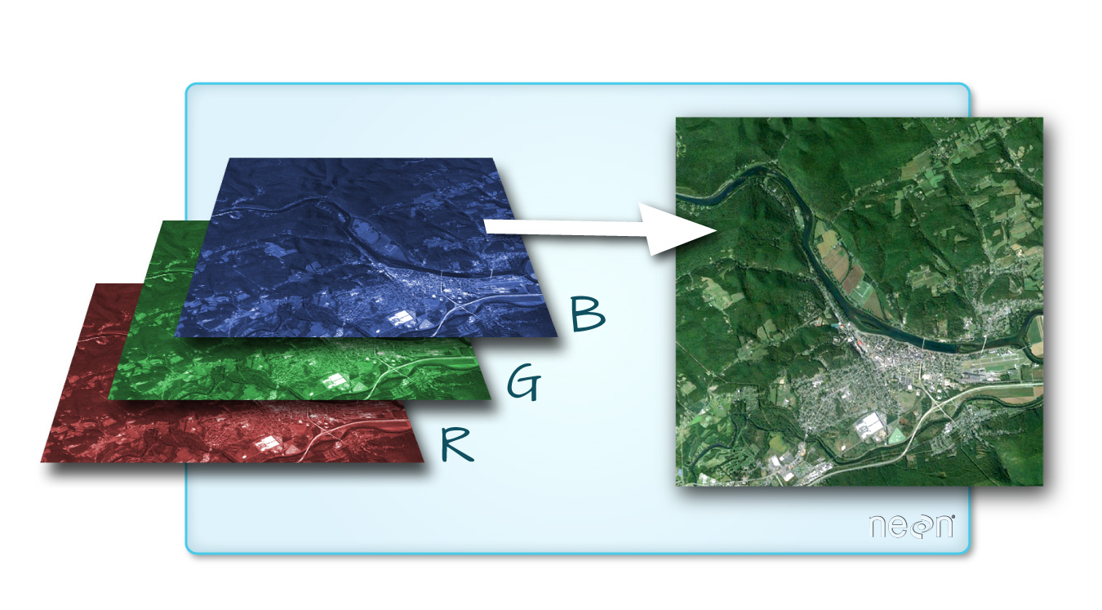
Multi-band Raster Data
A raster can contain one or more bands. One type of multi-band raster dataset that is familiar to many of us is a color image. A basic color image consists of three bands: red, green, and blue. Each band represents light reflected from the red, green or blue portions of the electromagnetic spectrum. The pixel brightness for each band, when composited creates the colors that we see in an image.

Slide 19
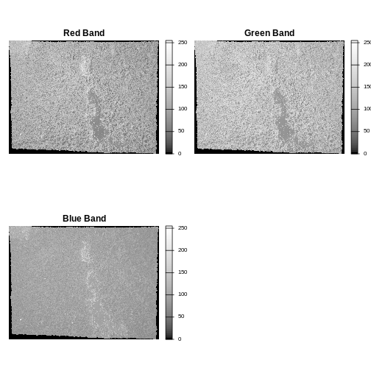
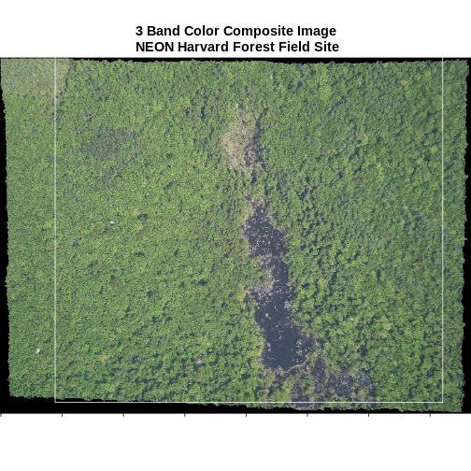
Multi-band Raster Data
We can plot each band of a multi-band image individually.

Slide 20
Raster Data Model Advantages
Better for storing Image data.
A powerful format for statistical and spatial analysis.
Easy and efficient overlaying.
Simple Data Structure.
Same Grid Cell for several attributes.

Slide 21
Raster Data Model Disadvantages
Dataset can be large, storage space can be a problem.
Network analysis is difficult to perform.
Loss of information when using large cells.
Insufficient projection transformation.
Difficult in a representation of Topology connections.

Slide 22
Raster Data Model Applications
Satellite imagery analysis.
Elevation modeling.
Weather forecasting.
Environmental monitoring.

Slide 23
Characteristics of Raster Data Model
Spatial Resolution
One of the most important characteristics of raster data is spatial resolution.
Spatial resolution refers to the size of the cells in the grid.
The smaller the cell size, the higher the spatial resolution.
High spatial resolution data is useful for analyzing small areas or features, while low spatial resolution data is better for analyzing larger areas.

Slide 24
Characteristics of Raster Data Model
Data Volume
Another characteristic of raster data is its data volume.
Raster data can contain a large amount of data, especially if the spatial resolution is high.
This can make working with raster data computationally intensive, as it requires a large amount of processing power and memory.

Slide 25
Characteristics of Raster Data Model
Data Type
Raster data can come in a variety of data types, including integer, float, and binary.
Integer data represents whole numbers, while float data represents decimal numbers.
Binary data is used to represent presence or absence, such as in land cover classifications.

Slide 26
Characteristics of Raster Data Model
Spatial Referencing
Spatial referencing is another important characteristic of raster data.
Raster data must be spatially referenced in order to be used in GIS.
This means that each cell in the grid must be associated with a specific geographic location.
This allows the data to be correctly located in space and used in conjunction with other spatial data.

Slide 27
Characteristics of Raster Data Model
Interpolation
Interpolation is the process of estimating values for locations where data is not available.
Interpolation is commonly used in raster data to fill in gaps or create a smoother surface.
However, interpolation can introduce errors and should be used with caution.

Slide 28
Characteristics of Raster Data Model
Resolution vs. Accuracy
It’s important to note that spatial resolution does not always equal accuracy.
While high spatial resolution data can provide more detail, it does not necessarily mean that the data is more accurate.
Accuracy is determined by the quality of the data source and the processing methods used.

Slide 29
Characteristics of Raster Data Model
Data Formats
Raster data can be stored in a variety of formats, including TIFF, JPEG, and GeoTIFF.
Each format has its own advantages and disadvantages, depending on the intended use of the data.

Slide 30
Characteristics of Raster Data Model
Band Count
Raster data can also contain multiple bands, with each band representing a different attribute of the geographic area.
For example, a satellite image may contain multiple bands that represent different wavelengths of light.

Slide 31
Characteristics of Raster Data Model
Projection
Raster data must be projected in order to be used with other spatial data.
This means that the data must be transformed from its original coordinate system to a common coordinate system that can be used with other data.

Slide 32
Characteristics of Raster Data Model
Metadata
Finally, raster data should always be accompanied by metadata, which provides important information about the data, such as the date of acquisition, the spatial resolution, and the data source.

Slide 33
Vector Data Model In GIS
Vector data represent the features as an individual point, and they are stored as pairs of (x, y) coordinates.
If these points are joined, they create a lines feature, or if they joined into a closed ring, they create a polygon, but all vector data fundamentally consists of lists of coordinates that define vertices and paths.
Vectors are frequently used in all kinds of applications.
One common area is urban planning, where land parcels and buildings are often represented as polygons, roads as polylines or polygons (road edge), and small features like telephone poles are represented by points.

Slide 34
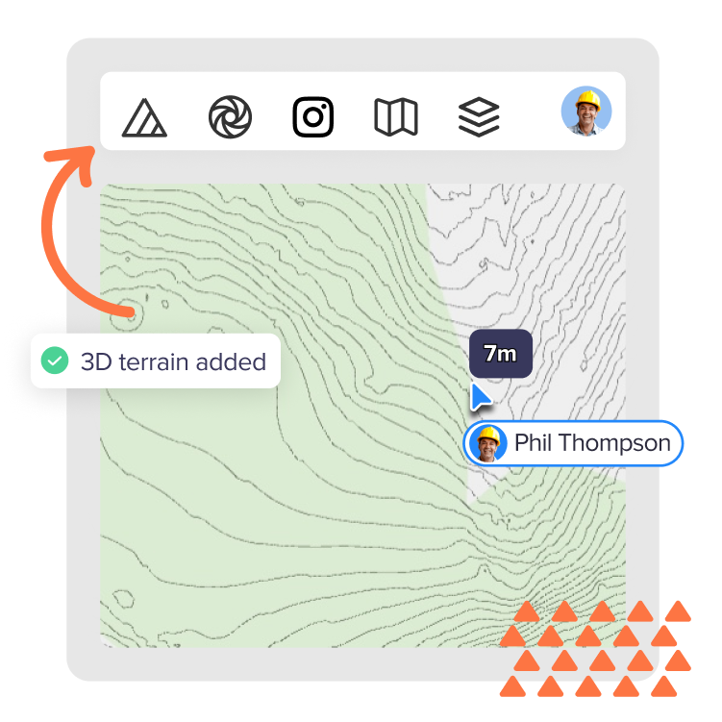
Vector Data Model In GIS
Vector data represents geographic features using points, lines, and polygons, defined by x, y, and sometimes z coordinates to include elevation or height information.
Unlike raster data, which is grid-based, vector data provides precise spatial representations.

Slide 35
Characteristics of vector data
Coordinate-Based: Uses x, y, and optionally z coordinates to define the shape and location of features, allowing for three-dimensional representation.
Discrete Data Representation: Ideal for representing discrete features like roads, property boundaries, and landmarks.
Scalability: Vector data can be easily scaled without losing detail, making it suitable for maps of various scales.

Slide 36
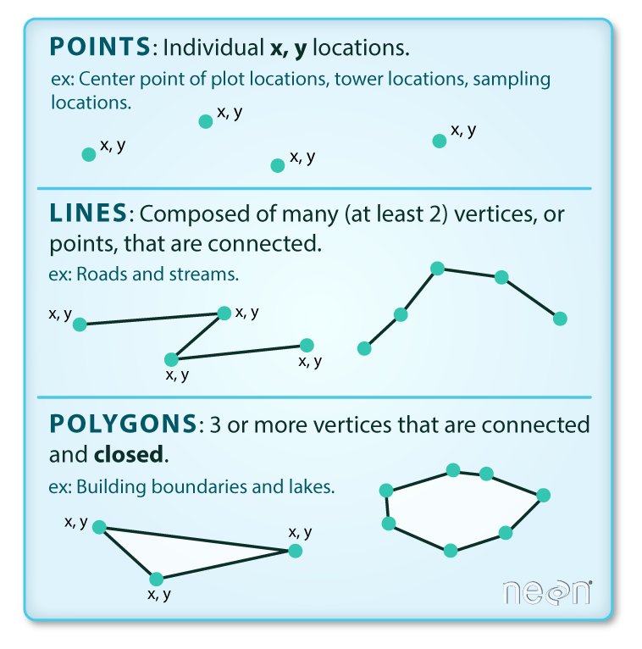
Vector data

Slide 37
Types of vector data
Points: Vector data representing discrete locations defined by x, y coordinates. Used for mapping specific features like landmarks, wells, or monitoring stations.
Lines (Polylines): Vector data representing sequences of points connected by straight or curved segments. Used for mapping features such as roads, rivers, and pipelines.
Polygons: Vector data representing enclosed areas defined by a series of connected points. Used for mapping features like administrative boundaries, land parcels, and lakes.

Slide 38
Types of vector data
Networks: Vector data representing interconnected sets of points and lines, used for modeling transportation networks (roads, railways), utility networks (electricity, water), and communication networks.
Contours: Vector data derived from raster DEMs, representing lines connecting points of equal elevation. Used for terrain visualization, engineering design, and landscape analysis.

Slide 39
Vector data formats
Shapefile (.shp) - A popular vector format consisting of multiple files (.shp, .shx, .dbf) that store geometric and attribute data.
GeoJSON (.geojson) - A format for encoding a variety of geographic data structures using JavaScript Object Notation (JSON).
KML/KMZ (.kml, .kmz) - Keyhole Markup Language and its compressed counterpart, used for displaying geographic data.

Slide 40
Geographical features are best to represent by below-mentioned types of geometry
Points When geographic features are too small to represent as polygons, points features are used; in other words, simple location.
For example, the locations of Trees, depth, Point of Interest.
These vector points are simply XY Co-ordinates.
Lines or polylines vector lines or polylines connect with each vertex with paths, they usually represent features that are linear such as rivers, roads, railroads, and pipelines.

Slide 41
Geographical features are best to represent by below-mentioned types of geometry
Polygons Cartographers used polygons to display geographic features that have an area.
For example, it may include lakes, park boundaries, buildings, city boundaries, or land uses.
Vector features are group into layers and features in a specific layer have the same geometry type.
For example, if a layer contains a Polygons feature, then GIS application will only allow a user to create a new polygon feature in the same layer.

Slide 42
Geographical features are best to represent by below-mentioned types of geometry
Each of the vector features is stored in a database along with their attributes.
For example, a database that describes a Street may contain a Street’s Name, Type, speed limit.
The User can perform spatial analysis with different geometries.

Slide 43
Vector Data Model Advantages
Compact data structure – Need less space for storing data.
Accurate Graphic output.
Since most information, e.g. printed version maps, is in vector form no data conversion is required.
Exact geographic location of data is maintained.
Easily make a connection between topology and network, efficient for network analysis.

Slide 44
Vector Data Model Disadvantages
The location of each vertex needs to be stored explicitly.
It has a complex Data Structure.
Difficult overlay operations.
High spatial variability is inefficiently represented.
Spatial analysis and filtering within polygons are impossible

Slide 45
Vector Data Model Applications
Road network analysis.
Parcel mapping.
Administrative boundary delineation.
Census data mapping.
better for network analysis, like finding the shortest path between points or managing utility networks.

Slide 46
Characteristics of Vector Data
Accuracy
One of the main advantages of vector data is its accuracy.
Because vector data represents objects using mathematical points, lines, and polygons, it can be very precise.
This makes it useful for applications that require high levels of accuracy, such as surveying, engineering, and urban planning.

Slide 47
Characteristics of Vector Data
Scalability
Another characteristic of vector data is its scalability.
Vector data can be scaled up or down without losing detail or clarity.
This means that it can be used to represent both large and small areas with equal accuracy.
For example, a vector map of a city can be zoomed out to show the entire city, or zoomed in to show individual streets and buildings.

Slide 48
Characteristics of Vector Data
Flexibility
Vector data is also very flexible.
It can be easily manipulated and edited using GIS software.
This means that it can be customized to meet specific needs or requirements.
For example, a GIS user could edit a vector map to highlight certain features or add new ones.

Slide 49
Characteristics of Vector Data
Topology
Topology is another important characteristic of vector data.
Topology refers to the relationships between different features in a map.
For example, the topology of a road network would include the connections between roads, intersections, and highways.
Topology is important because it allows GIS users to perform spatial analysis, such as routing and network analysis.

Slide 50
Characteristics of Vector Data
Attribute Data
In addition to spatial data, vector data also includes attribute data.
Attribute data is non-spatial data that is associated with a particular object or feature.
For example, a vector map of a city might include attribute data such as the population of each neighborhood or the number of businesses in each area.
Attribute data is important because it allows GIS users to perform statistical analysis and make informed decisions.

Slide 51
Characteristics of Vector Data
Data Storage
Vector data is typically stored in a database or file format.
Common file formats for vector data include shapefile, GeoJSON, and KML.
The choice of file format depends on the specific needs of the GIS user and the capabilities of the GIS software being used.

Slide 52
Differences between Raster Data Model and Vector Data Model
Key Differences | Raster Data Models | Vector Data Models
Representation | Data represented as a grid of pixels | Data represented as a series of points, lines, and polygons
Precision | Not suitable for precise data | Suitable for precise data
File Size | Can have a large file size | Can have a small file size
Visualization | Easy to visualize | Difficult to visualize
Editing | Not easily editable | Easily editable
Suitable Data | Suitable for continuous data | Suitable for discrete data

Slide 53
Raster or Vector?
While deciding whether to use a vector data model or raster data model in your work it entirely depends on the data you have as input and what your goals are for displaying or analyzing the data.
There are many analysis that make use of both data models i.e. vector and raster or require the conversion of one data model to another.
While conversion is a common procedure, it’s suggested that any translation between data model to be kept at a minimum to avoid accumulating error in your spatial model.

Slide 54
Raster or Vector?
he size of the dataset should be a consideration, as raster dataset can be quite large and difficult for some workstation to process in a timely manner.
Vector data model is recommended for analysis, unless modeling a continuous surface and when using a raster data model it is important to use cell sizes that are appropriate for analysis.

Slide 55
Object vs. Field
While the vector/raster distinction focuses on data structure, the object vs. field perspective focuses on how we conceptualize spatial phenomena.
This distinction is especially useful when deciding how to model and analyze different types of spatial features.

Slide 56
Object View
The object view treats spatial features as discrete entities that exist independently and occupy specific locations.
These features do not occur everywhere in space.
Examples include point locations of cities, road networks, or polygonal representations of land parcels or urban areas. Objects are typically represented using the vector data model

Slide 57
Field View
The fiefld view treats spatial phenomena as continuous surfaces or distributions that vary across space.
A field is a property that can be measured at any location within a study area.
Common examples include surface elevation, temperature, or precipitation. These are typically represented using the raster data model.

Slide 58
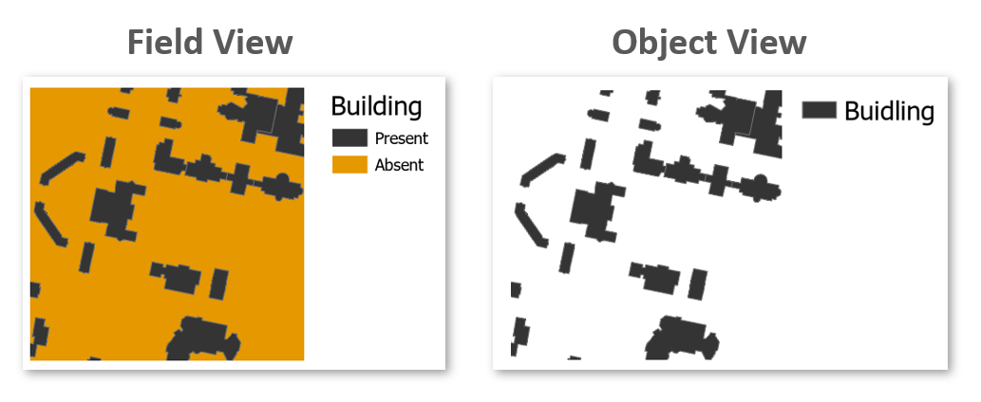
Object vs. Field
Some features can be represented as either objects or fields, depending on the analytical context.
For instance, the presence or absence of buildings can be modeled as:
Objects, if we are interested in the location and shape of individual buildings.
Fields, if we are interested in identifying areas where buildings do or do not exist (e.g., using a binary raster where 1 = presence, 0 = absence).
Field and Object representation of buildings.
Ultimately, the choice between object and field representations depends on the nature of the phenomenon and the goals of the analysis.

Slide 59
Scale
In GIS, scale refers to the ratio between a distance on the map and the corresponding distance in the real world. For example, a scale of 1:10,000 means that one unit on the map represents 10,000 units on the ground.
It’s important to distinguish between two uses of the term:
Cartographic scale refers to the map’s level of detail.
Analytical scale refers to the spatial extent or resolution of a study

Slide 60
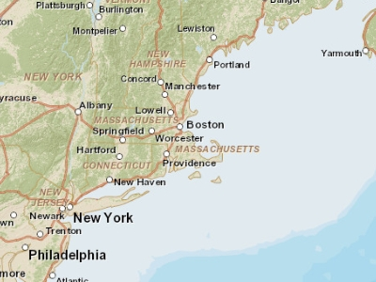
Scale
In cartographic terms, a large scale map (e.g., 1:10,000) shows a small area in great detail, while a small scale map (e.g., 1:10,000,000) shows a large area with less detail. This is opposite to how “large scale” is often used in everyday language, where it implies a broad or extensive scope.
The following two maps of the Boston region illustrate this difference:
At a small scale (1:10,000,000), Boston and other cities may be represented as simple points.
At a large scale (1:34,000), Boston may be represented as a detailed polygon, and roads may appear as polygons rather than simple lines.
Map of the Boston area at a 1:10,000,000 scale. Note that in geography, this is considered small scale whereas in layperson terms, this extent is often referred to as a large scale (i.e. covering a large area).

Slide 61
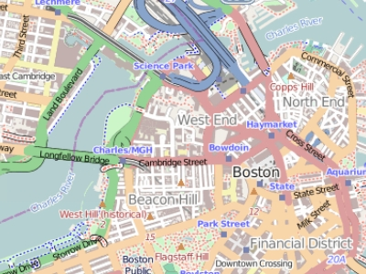
Scale
In cartographic terms, a large scale map (e.g., 1:10,000) shows a small area in great detail, while a small scale map (e.g., 1:10,000,000) shows a large area with less detail. This is opposite to how “large scale” is often used in everyday language, where it implies a broad or extensive scope.
The following two maps of the Boston region illustrate this difference:
At a small scale (1:10,000,000), Boston and other cities may be represented as simple points.
At a large scale (1:34,000), Boston may be represented as a detailed polygon, and roads may appear as polygons rather than simple lines.
Map of the Boston area at a 1:34,000 scale. Note that in geography, this is considered large scale whereas in layperson terms, this extent is often referred to as a small scale (i.e. covering a small area).
Understanding scale is essential for choosing appropriate data and representation methods in GIS analysis.

Slide 62
Attribute Tables
In GIS, attributes are non-spatial data that describe the characteristics of spatial features–such as a city’s population, a road’s name, or a parcel’s land use type. A feature on a GIS map is linked to its record in the attribute table by a unique numerical identifier (ID).
Each feature in a GIS layer is associated with one or more records in the attribute table, enabling a one-to-one or many-to-one relationship between geometry and descriptive data. Most GIS software allows users to click on a map feature and view its associated attributes directly.
Raster datasets can also store attribute information, but only when pixel values represent discrete categories (e.g., land cover classes). In such cases, each unique integer value may correspond to a class label or description. However, most raster datasets used in this course will represent continuous data and will not include attribute tables.

Slide 63
Measurement Levels
Attributes data can be broken down into four measurement levels:
Nominal data which have no implied order, size or quantitative information (e.g. paved and unpaved roads)
Ordinal data have an implied order (e.g. ranked scores), however, we cannot quantify the difference since a linear scale is not implied.
Interval data are numeric and have a linear scale, however they do not have a true zero and can therefore not be used to measure relative magnitudes. For example, one cannot say that 60°F is twice as warm as 30°F since when presented in degrees °C the temperature values are 15.5°C and -1.1°C respectively (and 15.5 is clearly not twice as big as -1.1).
Ratio scale data are interval data with a true zero such as monetary value (e.g. $1, $20, $100).

Slide 64
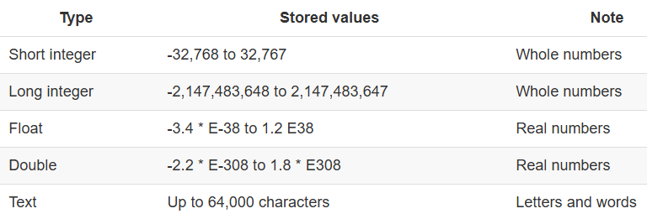
Data type
In GIS, choosing the correct data type for an attribute is essential for accurate data storage, efficient processing, and meaningful analysis. ArcGIS supports several common data types, including integer, float, double, and text. The choice of data type should align with the attribute’s measurement level and intended use.
The following table summarizes popular data types available in most GIS applications:

Slide 65
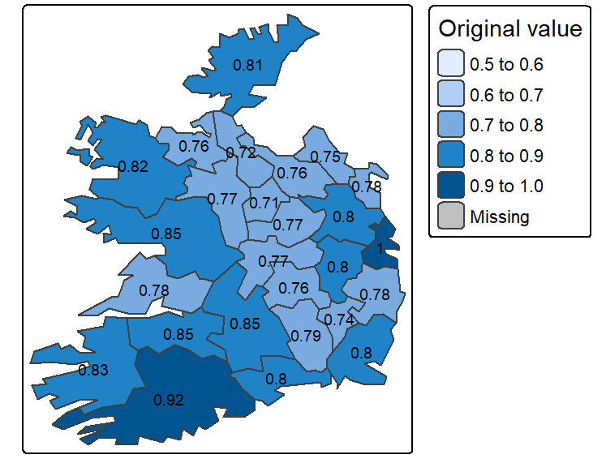
Data type
While whole numbers can be stored as floats or doubles (e.g., storing 2 as 2.0), doing so increases storage requirements. This may not be a concern for small datasets, but for large datasets with tens of thousands of records, it can impact file size and processing speed.
Conversely, storing decimal values as integers can lead to significant data loss. For example, values such as 0.2, 0.01, 0.34, 0.1, and 0.876 would all round to either 0 or 1, obscuring meaningful differences. This can distort map outputs, especially in choropleth visualizations, where subtle variations are important as shown in the following two figures
Map of data represented as decimal (float) values.

Slide 66
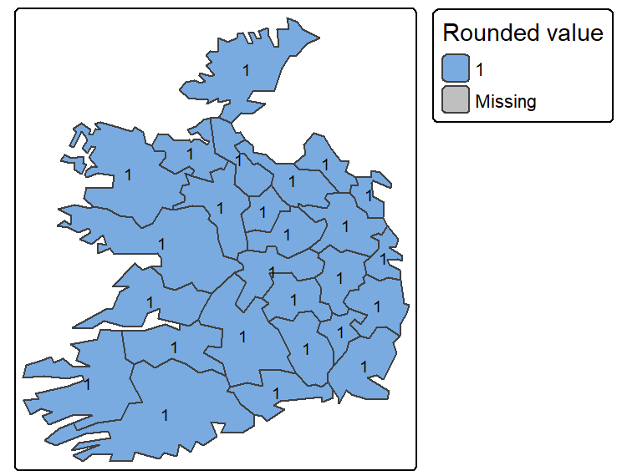
Data type
While whole numbers can be stored as floats or doubles (e.g., storing 2 as 2.0), doing so increases storage requirements. This may not be a concern for small datasets, but for large datasets with tens of thousands of records, it can impact file size and processing speed.
Conversely, storing decimal values as integers can lead to significant data loss. For example, values such as 0.2, 0.01, 0.34, 0.1, and 0.876 would all round to either 0 or 1, obscuring meaningful differences. This can distort map outputs, especially in choropleth visualizations, where subtle variations are important as shown in the following two figures
Map of same data represented as integers instead of float.

Slide 67
GIS Data Management
Effective data management is essential to any GIS workflow. Whether working with spatial data for analysis, visualization, or sharing, understanding how GIS files are structured, stored, and organized ensures efficiency, and reproducibility.
This chapter introduces the most common GIS file formats used for both vector and raster data, highlighting their strengths, limitations, and compatibility across platforms.
Beyond file formats, the chapter explores best practices for managing GIS projects within software environments like ArcGIS. Topics such project folder organization and file dependencies are covered to help avoid common pitfalls when working with complex spatial datasets.

Slide 68
GIS File Data Formats
In the GIS world, you will encounter many different GIS file formats. Some file formats are unique to specific GIS applications, others are universal.
For this course, we will focus on a subset of spatial data file formats: shapefiles for vector data, Imagine and GeoTiff files for rasters and file geodatabases and geopackages for both vector and raster data.

Slide 69
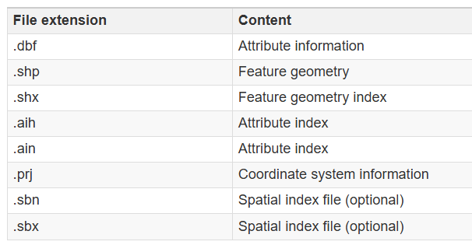
Vector Data File Formats - Shapefile
A shapefile is a file-based data format native to ArcView 3.x software (a much older version of ArcGIS Pro). Conceptually, a shapefile is a feature class–it stores a collection of features that have the same geometry type (point, line, or polygon), attributes, and spatial extent.
Despite its name, a shapefile is not a single file but a set of files that work together. At minimum, three files are required, but up to eight may be present. Each file shares the same base name but has a different extension, as shown below:
While shapefiles are widely supported and simple to use, they have notable limitations, such as lack of support for topology, limited attribute field name lengths, and constraints on file size and data types.

Slide 70
File Geodatabase
A file geodatabase is a relational database storage format developed by Esri. It is a more complex and versatile structure than the shapefile, consisting of a .gdb folder that houses dozens of files. These files collectively store spatial features, attribute tables, indexes, metadata, and rules that define relationships between features.
One of the key advantages of a file geodatabase is its ability to store multiple feature classes (e.g. vector layers) and raster datasets within a single container. It also supports topological rules, which allow users to define spatial relationships between features—such as shared boundaries or connectivity between lines.

Slide 71
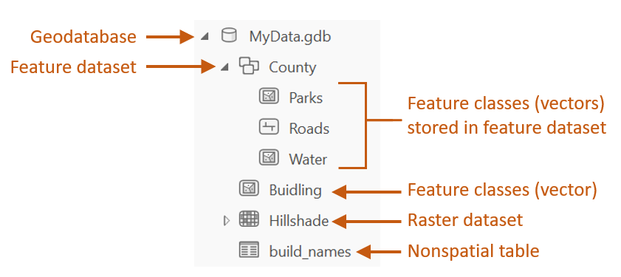
File Geodatabase
An example of a geodatabase’s contents is shown in the following figure.
Sample content of an ArcGIS file geodatabase.
File geodatabases are efficient for managing large datasets and support advanced GIS operations. However, they are proprietary to ESRI and may have limited compatibility with non-ESRI software.

Slide 72
GeoPackage
An GeoPackage is a modern, open-standard data format built on top of SQLite–a lightweight, self-contained relational database. It is non-proprietary and designed for efficient storage and transfer of spatial data. One of its key advantages is compactness: coordinate values, metadata, attribute tables, projection information, and even multiple layers (vector and raster) can be stored in a single .gpkg file.
This structure makes GeoPackage highly portable and ideal for sharing complex GIS projects. Unlike shapefiles, which require multiple files, or file geodatabases, which are proprietary to Esri, GeoPackage offers a unified and open solution compatible with a wide range of applications including QGIS (2.12 and up), R, and ArcGIS Pro.

Slide 73
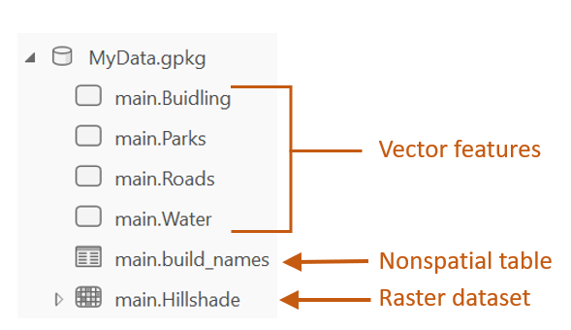
GeoPackage
An example of a geopackage’s contents is shown in the following figure.
Sample content of a geopackage.
While GeoPackage supports many advanced features, performance may vary depending on the software and dataset size. Some specialized capabilities, such as topology rules, may be more limited compared to Esri’s file geodatabase.

Slide 74
Raster Data File Formats
Raster data represents spatial phenomena as a grid of cells (pixels), each storing a numeric value. These values can represent elevation, temperature, and land cover for example. Rasters are particularly well-suited for modeling continuous surfaces and are commonly used in remote sensing and environmental analysis.
One important characteristic of raster data is pixel depth, which defines the range of distinct values a raster can store. For example, a 1-bit raster can only store two values (0 and 1), while a 16-bit raster can store up to 65,536 distinct values. The following figure illustrates how pixel depth affects the range of values.

Slide 75
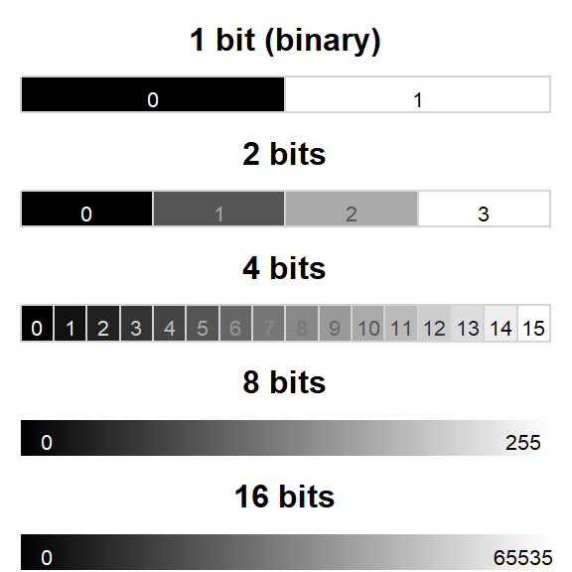
Raster Data File Formats
Examples of different pixel depths.
One important characteristic of raster data is pixel depth, which defines the range of distinct values a raster can store. For example, a 1-bit raster can only store two values (0 and 1), while a 16-bit raster can store up to 65,536 distinct values. The following figure illustrates how pixel depth affects the range of values.
Some of the most popular raster file formats are listed next

Slide 76
Imagine
The Imagine file format was originally created by an image processing software company called ERDAS. This file format consists of a single .img file. This is a simpler file format than the vector shapefile. It is sometimes accompanied by an .xml file which usually stores metadata information about the raster layer.

Slide 77
GeoTiff
A popular public domain raster data format is the GeoTIFF format. It extends the standard TIFF (Tagged Image File Format) by embedding georeferencing information directly within the file. This includes coordinate system, projection, datum, and spatial resolution, allowing the raster to be accurately placed in geographic space without the need for auxiliary files.
GeoTIFF is widely supported across GIS and remote sensing software, including QGIS, ArcGIS and R. Its portability, platform independence, and open specification make it a popular format for sharing raster data.
GeoTIFF also supports internal compression (e.g., LZW, DEFLATE, JPEG), which can reduce file size.

Slide 78
File Geodatabase
A raster file can also be stored in a file geodatabase alongside vector files. Geodatabases have the benefit of defining image mosaic structures thus allowing the user to create “stitched” images from multiple image files stored in the geodatabase. Also, processing very large raster files can be computationally more efficient when stored in a file geodatabase as opposed to an Imagine or GeoTiff file format.

Slide 79
GeoPackage
In addition to vector data, GeoPackage also supports raster data storage. Raster layers are stored in a tiled format within the same .gpkg file making it a compact and portable solution for mixed data types. GeoPackage is a good choice for sharing raster data across platforms due to its open standard and single-file structure.

Slide 80
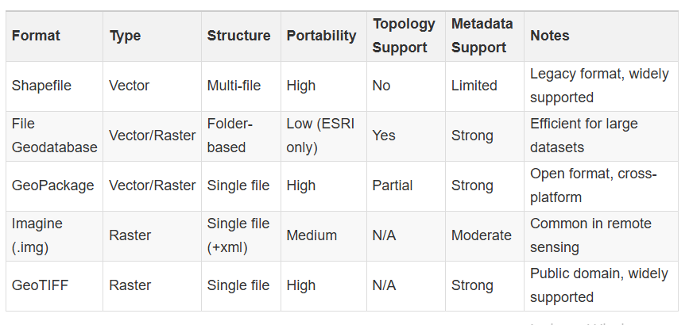
Comparison table
The following table summarizes key characteristics of the most commonly used GIS file formats discussed above. This comparison includes aspects such as data type, structure, portability, and support for topology and metadata.

Slide 81

Types of spatial data
Geographic Information System (GIS) is a powerful tool for capturing, analyzing, and presenting spatial data.

Slide 82

Myself
Dr. Giri Rajasekhar Gunnu
AI, Digital Twin & Industry Solutions Specialist | Industry 4.0 Specialist | Predictive Solutions Expert | Marine and Offshore Consultant
Professor of Practice, Andhra University
📧 g.giri.iitm@gmail.com
🔗 LinkedIn: girigunnu

Slide 83
Q&A
Welcome your questions and insights from all ranks
Your feedback helps us improve our CBPM implementation and ensures it meets the real-world needs of our fleet

